Slide 1
Neighbourhood Plans
What are they, and what is Saltash doing about it?
Steve Besford-foster

Slide 2
What is a Neighbourhood Plan?
A Neighbourhood Plan is a new way for local communities to have real influence on how the area in which they live is planned
Introduced through the Localism Act 2011.
A new legal ‘right’ for local people to make a Plan for their neighbourhood.
Notes:
Neighbourhood (Development) Plans
statutory development plan forms part of the Local Development Framework
Neighbourhood Development Orders
grant planning permission for certain kinds of development within specified area
Community Right to Build Orders
grant planning permission for development schemes

Slide 3
Why does Neighbourhood Planning matter?
Its created by the local community through it’s local council.
The plan must pass a referendum of all local electors.
When 'Made' a Neighbourhood Plan becomes part of the statutory development plan
Must be taken into account by the Local Planning Authority when making planning decisions
So Neighbourhood Planning gives local communities a direct say in decisions that affect them
If you don’t produce a Neighbourhood Plan, the future of where you live will continue to be decided elsewhere.
Notes:
The planning system is essential for supporting economic growth, improving people’s quality of life, and protecting the natural environment.
First time such a local power has been available since pre-1974, and an opportunity to rebuild ‘localism’
Neighbourhood Planning:
Stimulates community awareness of local issues
Stimulates community involvement in resolving local issues
Encourages community cohesion
Helps local communities to reach tough decisions
Reduces cynicism about politics and local government
Releases community energy and initiative
Increases amount of Community Infrastructure Levy distributed locally

Slide 4
Sustainable Development
Neighbourhood Plans cannot be used to stop growth!
To get the best outcome for the Town, your Neighbourhood Plan should try to meet the needs of the people who live, work, learn and visit Saltash in a way that supports sustainable development.
In a nutshell:
‘meeting the Saltash community’s present needs without harming the ability of future generations to meet their needs’.

Slide 5
Sustainable Development
Guiding principles of sustainable development:
Living within the planet’s environmental limits – by protecting and enhancing our natural and man-made environment, and responding to climate change.
Ensuring a strong, healthy and just society – by meeting present and future needs for the housing, work and services that support the wellbeing of all our community.
Achieving a sustainable economy – by supporting actions that build prosperity for all and use resources wisely.
Promoting good governance – by ensuring that you are all involved in creating the Saltash Neighbourhood Plan.

Slide 6
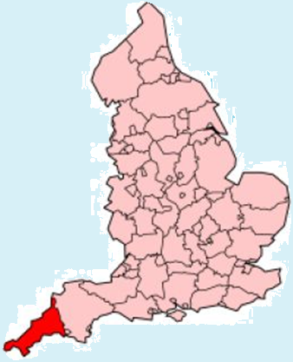
How does the Saltash NDP fit in?
NATIONAL PLANNING POLICY FRAMEWORK
The Government’s planning policy for England is set out in the National Planning Policy Framework (NPPF).
CORNWALL POLICY
Cornwall Council holds responsibility for setting planning policy in the Cornwall Local Plan and determining most local applications.
NEIGHBOURHOOD PLAN
The Saltash Neighbourhood Plan is being led by Saltash Town Council and will enable local residents and businesses to have a greater say in the planning and development of the Town

Slide 7
National Progress to end May 2015

Slide 8
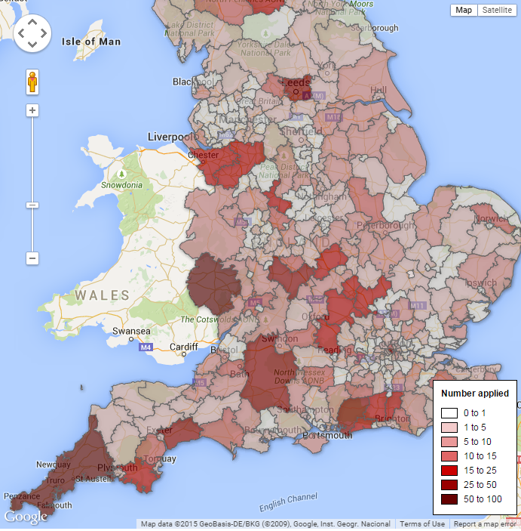
The National Scene

Slide 9
Activity in Cornwall
Blisland NDP
Bude-Stratton NDP
Calstock NDP
Camelford NDP
Crantock NDP
Crowan NDP
Deviock NDP
Falmouth NDP
Feock NDP
Fowey NDP
Gwinear-Gwithian NDP
Hayle NDP
Illogan NDP (at designation)
Landulph NDP
Landrake With St Erney NDP
Lanlivery NDP
Lanreath NDP
Linkinhorne NDP
Liskeard NDP
Looe NDP
Lostwithiel NDP
Ludgvan
Menheniot NDP
Mevagissey NDP
Michaelstow NDP
Morval NDP
Newquay NDP
Padstow NDP
Penzance NDP
Porthleven NDP
Probus NDP
Quethiock NDP (Submitted)
Rame Peninsula NDP
Roche NDP
Roseland Peninsula NDP (Submitted)
Saltash NDP
South Hill NDP
St Blaise NDP
St Cleer NDP (Withdrawn)
St Endellion NDP
St Enoder NDP
St Erth NDP
St Eval NDP (Made)
St Gennys NDP
St Germans NDP
St Ive NDP
St Ives NDP (Submitted)
St Mellion NDP
St Mewan NDP
St Minver's NDP
St Neot NDP
St Sampson NDP
Stoke Climsland NDP
Tintagel NDP
Torpoint NDP
Tresmeer NDP
Truro and Kenwyn NDP
Tywardreath and Par NDP
Wadebridge, St Breock and Egloshayle NDP
Wendron NDP
Werrington NDP
Withiel NDP
Notes:
62 NDPs in total , 5 submitted for examination, of which only 1 has passed examination and was strongly supported at the referendum (92% in favour)
But turnout was only 34% of 644 electors, so that’s 202 in favour, 16 against, and 426 who wouldn’t say. How legitimate is that?

Slide 10
What can be included?
Environment
Design guidance & design policies
Protection of ‘Local Green Space’
Coalescence of settlements
Small scale renewable energy
Biodiversity
Control of advertisements
Protection of traditional shop fronts
Economy
Land for jobs
Protection of car parks
Town centre redevelopment
Workshop development
Working from home
New retail
Protection of business uses
Notes:
Local Green Space designation is a way to provide special protection against development for green areas of particular importance to local communities.

Slide 11
What can be included?
Housing
Allocation of land for housing
Flats in town centres
Sustainable Homes
Car parking standards
Affordable and social housing
Housing for local older people
Conversion of redundant buildings
Housing on farms
Limit extensions on small properties
Community Facilities
Protection & allocation allotments
Cycle & pedestrian links
Protection of local shops and pubs
Developer contributions to community facilities
New community facilities
Broadband provision
Notes:
NDOs and CRtB orders can do more….

Slide 12
What can’t be included?
Things that can’t be got through land-use policies must not be included within main policy document (e.g. the frequency of buses, street cleansing, graffiti control, post box provision, community group activity);
But can be listed as separate projects in a separate section;
And may be ‘influenced’ by design (e.g. developer provision of bus-bays, space for community hubs etc)

Slide 13
Important limits…and opportunities
Can’t simply copy Local Plan policies.
Can’t be contrary to relevant strategic Local Plan policies
Can’t undermine the strategic elements of the Local Plan
Can add to Strategic policy
Can conflict with “detailed” Local Plan elements
Can make planning more suited to local conditions.

Slide 14
Format of Plans
Evidence base
General Policies
general requirements which apply across the Plan area to all developments.
Criteria Based Policies
targeted on particular types of developments or themes clearly identifying the requirements that need to be met with indicators.
Site Specific Policies
applying to particular areas of land, and individual or groups of sites, often referred to as ‘allocations’.
A reasoned justification for each policy.
All policies should be tested to ensure that they deliver sustainable development
Also check that a policy doesn’t contravene European or human rights legislation.
Maps

Slide 15
The Golden Thread
Community Engagement Evidence Base
Aims and Objectives
Policies and Proposals
Action on the ground.

Slide 16
Creating the Plan
Community Engagement
Approving the Plan
Designation of Saltash Neighbourhood Area
Initial Community Consultation
Saltash Neighbourhood Plan becomes part of statutory Development Plan
Form Steering Group
Community Membership of Steering Group
Plan is ‘Made’ in law
Initial scoping of themes
Initial Community Engagement
Referendum
We Are Here!
Identify issues and aims
Modifications
Develop evidence base
Develop policies & proposals
Independent Examination
Workshops & continuing Community Engagement
Submit to Cornwall Council
Publish Neighbourhood Plan
Statutory Consultation
(6 weeks)

Slide 17
Community Involvement
Consultation
Engagement
‘Here is the Plan we have written for you. Tell us what you think of it.’
‘Tell us in next 6 weeks or we will ignore you.’
‘We don’t want to talk to you: just fill in the form’
‘You can find the Plan under the desk in our office, when its open.’
‘If we don’t like what you say, then we are sure there are good reasons to ignore you !’
‘Lets all get together and write the Plan’
‘What are the issues affecting our town?’
‘Lets have a chat about it and see if together, we can all come up with some good ideas to fix them’
‘And when the work is finished, lets all vote on it’

Slide 18
Parish/Town Council Role
Your Town Council has a formal power and responsibility for preparation of the NDP, it is the ‘qualifying body’ in law.
Leads the NDP supported by a mixed steering group drawn from the community
Must involve and engage the community
Decision making – to approve budget, draft plan etc
Actively deliver (seeking funding, working with partners, Liaise with other bodies etc)

Slide 19
Cornwall Council Role
A legal duty to support
Assist with:
Engagement with community, agency and other bodies
preparation of materials and documents
writing the plan
Technical, policy and legal guidance
Advise if think will not pass examination
Statutory duties (consultation on neighbourhood area, organise & fund examination and referendum)
However - It is your community's project and your community's plan!

Slide 20
Community Referendum
If examiner is satisfied basic conditions & EU & human rights requirements met a referendum must be held
One yes/no question:
"Do you want Cornwall Council to use the neighbourhood plan for Saltash to help it decide planning applications in the neighbourhood area?“
If a majority ‘Yes’ vote (50% + 1) LPA must 'Make' the plan & bring into legal force
Can include voters from outside Plan area if they are significantly affected
The 50%+1 is of those who vote on the day (i.e. 18 and above and registered, not 50% of the electorate

Slide 21
Making the Plan – The Law
If Plan earns a majority vote it is formally ‘Made’ - not ‘adopted’ – the Local Planning Authority and the Qualifying Body has no choice! (Planning and Compulsory Purchase Act 2004 Sec 38A (4))
Neighbourhood Plans are legally recognized as part of the Development Plan (Sec 38 (3) of the Planning and Compensation Act 2004 as amended)
The Neighbourhood Plan must be taken into account when planning applications are determined with the same weight as the Local Plan. (Sec 70 (1) and (2) of the Town and Country Planning Act)

Slide 22
Next……Applying the Plan
Monitoring use by the Local Planning Authority
Bringing forward proposals
Cornwall Council or other bodies
Investors and Developers
Interventions by Town Council
Seeking and using Community Infrastructure Levy
Review and update in light of changing circumstances….

Slide 23
How much does it cost?
How long is a piece of string?
Around £35,000 + costs of Independent Assessment and Referendum
Much, much more if land allocations made
Who pays?
Preparation - Saltash TC, with help from Locality grant of £8,000
Independent Assessment and Referendum – Cornwall Council, with help from a block grant from DCLG
Maximise use of volunteer support (e.g. DIY surveys) ‘pro-bono’ professional support, sponsorship, and other grant sources.

Slide 24
The Benefits
Local planning policies given status in law
Planning Authority must use them
Build community consensus around a positive vision for the next ten, fifteen, twenty years
Generate new projects and ideas, and gives them the land-use support needed to deliver them
Create new partnerships to get things done
Motivates more people to become involved in community activity
Helps people make sense of why things are the way they are, and how to change them
The community legacy can be as important as the content of the Plan!

Slide 25
Saltash Neighbourhood Plan
Currently at initial community engagement stage – hosting the conversation about the planning of the area.
Community engagement strategy:
Raising awareness through leaflets, posters, press and social media
Informing people through ‘drop-in’ exhibitions, website, attendance at events
Gathering views through questionnaire, ‘drop-in’ sessions, events
In late summer, ‘Theme Teams’ will begin to develop options
Plan written over winter 2015/16
Submission spring 2016
Independent Assessment and Referendum late spring/summer 2016
Plan ‘Made’ summer 2016.

Slide 26
Social Media
http://plan4saltash.co.uk
Twitter
Facebook

Slide 27
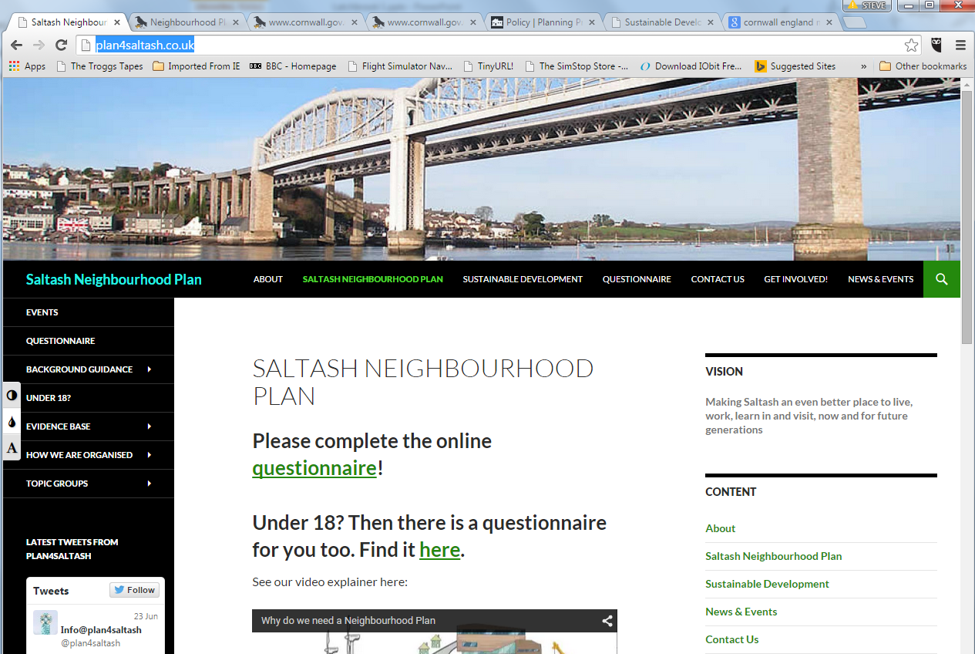

Slide 28
Cornwall Local Plan Examination
Inspector has suspended the Examination because the Plan is
‘Unsound’
Not compliant with the Regulations
CC to consider making changes and consulting on them, before reopening the Inquiry.
Sustainability Appraisal is not adequate nor regulatory compliant
Poor justification and testing of the apportionment of housing both to and within CNAs between towns and rural areas
CC to do revised population model and update housing figures accordingly
Some increase in the general numbers may help provide more affordable housing
7% should be added for loss of dwellings to second/holiday homes

Slide 29
Cornwall Local Plan Examination
Need and demand for housing for private rented, self-build, older people and households with ‘specific needs’ has not been adequately addressed.
Affordable housing 40% requirement to go down to 30% in areas like Saltash
More sophisticated linkage between economic growth and housing growth required
Employment land strategy is out of date: doesn’t reflect the LEP strategy and must be updated
Any over supply of employment land might go for alternative uses
40% ‘churn rate’ to be added to employment land requirement

Slide 30
Cornwall Local Plan Examination
The Inspector has not proposed an alternative strategy for the Plan.
Does not call for nor imply a sizeable ‘uplift’ in the overall housing numbers. A more reasonable ‘guestimate’ would be around 10%,
Of far greater concern is the re-apportionment of housing and employment land that might occur between CNAs and within them
At local level, this could multiply the impact of any uplift in the housing figures, particularly for those CNAs judged to be ‘less sensitive’ in environmental terms that are well placed in terms of accessibility.
Will Saltash have to find more land for housing and industry?

